Slide 1
Capstone Project – OkCupid Data
Machine Learning Fundamentals
Ricardo Cao
November 12, 2018

Slide 2
Table of Contents
1 - Exploratory Data Analysis
2 - Cleaning the DataFrame
3 - Data Enrichment
4 – Some columns created
5 – Questions to answer
6 - Regression Model 1 (Multiple Linear Regression)
7 - Regression Model 2 (KNN Regression)
8 - Classification Model 1 (KNN)
9 - Classification Model 2 (SVM)

Slide 3
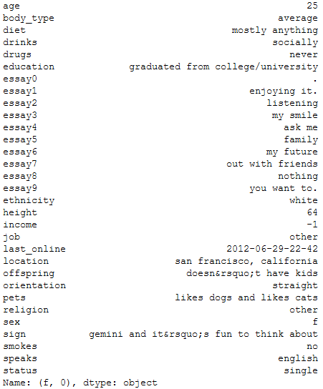
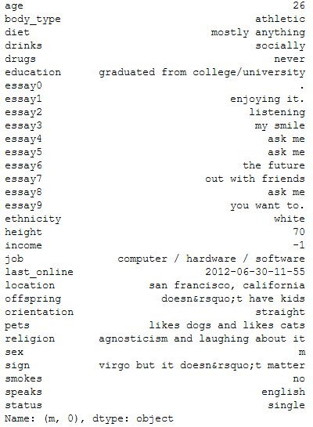
EDA table 1 – The average profile per sex

Slide 4
The previous slide gave us a general idea of the average answers per sex.
The average female is around 25 years old, with average body type, graduated from university/college, a height of 64 inches (~5.3 feet), did not report her income, has a job title of "other", of white ethnicity, with no kids, straight, doesn't smoke, single and speaks English.
The average male is around 26 years old, with an athletic body type, graduated from university/college, has a height of 70 inches (~5.8 feet), did not report his income, has a job title of "computer / hardware / software", of white ethnicity, with no kids, straight and speaks English.

Slide 5
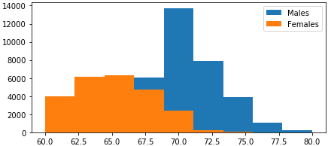
EDA 2 – Heights per sex
Histogram shows reported heights per gender.
Females reported heights are around 62.5 to 65 inches (~5.2 to 5.4 feet)
Males reported heights have a peak at around 70 inches (~ 5.8 feet).

Slide 6
EDA conclusions
Most of the data from the dataset is text.
There are only 3 columns that are numerical: age, height, income.
There are 59,946 entries.
48,442 (or ~ 81%) of the data contains -1 as the amount. This most likely indicate that people did not want to share their income.
2 columns have 40% or more of the entries missing:
59% of the offspring column entries are missing.
41% of the diet column entries are missing.
There are heights that appear to be less than 5 feet (60 inches) and over 6.6 feet (80 inches). We will set the criteria to only include people whose height are between 60 inches and 80 inches.

Slide 7
24,117 (or 40%) of the profiles belong to females.
Males make about 28% more than the females based on the self reported income, after excluding values of -1 and of 1 million.
2 profiles indicate that they are 109 and 110 years old.
From the plots we can see that most (30,017 or ~50%) of the profiles indicate an age between 21 and 30.
There are about 3,584 people over 50 years old
1,683 people indicated that they have some sort of education or work in space camp.

Slide 8
Questions
Regression:
Are we able to predict the age based on variables such as age, income and body type?
Classification:
Are we able to predict sex based on the reported: diet, smoke, drinks, drugs and body type?
The above questions were chosen because the data contains very messy data and the above columns contained some of the cleaner data.
Variables with a manageable number of choices.
Little pre-processing and parsing of the answers.

Slide 9
Columns Created
Age_Group – a column which was added to show part of which age group the person belonged to.
Column was created using pd.cut and setting the age groups that we wanted to group by. We also passed in the labels so that the column will have the necessary labels.
Body_type_fit and body_type_unfit – Column that were created for the classification models.
Created using the pd.get_dummies(). We had narrowed down the body types into fit and unfit. The get_dummies() will assign a 1 if the rows has that value and a 0 otherwise. Meaning, if the row contains the body type fit then body_type_fit will get a 1 and body_type_unfit will get a 0.

Slide 10
Regression - Want to predict age based on income, body type and sex.
Multiple Linear Regression
KNN Regression
Very simple model, assumes linearity of data.
Easy to interpret.
Time to run (training): 0.016000 s
Accuracy (R²) = 0.124963
Non-parametric model, does not make assumptions about the linearity of the data.
Complex to understand results, need to find optimal number of neighbors.
Time to run (training): 0.015000 s
Accuracy (R²) = 0.130319

Slide 11
Regression - Conclusions
Both regression model tested were not very good at predicting the results.
They were not even close to 20% in terms of accuracy.
There should be a deeper dive into the rest of the variables to see if there are any more variables that could be added to improve the model.
There was a lot of missing income information which in turn affected the number of samples that could be used, with a cleaner dataset it could be a better model.
KNN Regression works slightly better for this question that Multiple Linear Regression.

Slide 12
Classification – Want to predict sex based on the reported: diet, smoke, drinks, drugs and body type
K-Nearest Neighbors
Support Vector Machines
Makes no assumptions about the linearity of the data.
It is sensitive to outliers.
Need to select features carefully.
Time to run (training): 0.010000 s
Precision: 0.59
Recall: 0.60
F1 score: 0.59
Can modify the kernel to be linear or non-linear.
Not affected by outliers.
Needs to be tuned using the cost function.
Time to run (training): 0.011000 s
Precision: 0.64
Recall: 0.65
F1 score: 0.64

Slide 13
Classification - Conclusions
Both models seem to be decent at predicting the data.
There could be more tweaking done in order to increase the accuracy of the models.
With more tuning of the models we could get better results in predicting points.
SVM seems to be a better approach for solving the particular question with the particular dataset.
It has performed better in terms of accuracy, recall and F1-score.

Slide 14
Conclusion
The regression approaches are both very bad. The question should be modified, or the models for regression should be corrected by implementing new variables or modifying the existing variables being used for them.
We are unable to use regression to predict age based on sex, income and body type.
The classification approaches both work good enough, although they could be fine tuned to perform better.
We are able to make some predictions of sex based on the diet, smoke, drinks, drugs and body type.

Slide 15
Next Steps
Work on analyzing the short answer questions.
Work on more pre-processing of the data, since the data set contains very messy data.
Example. Over 200 unique ethnicity answers.
Learn method to parse and utilize the words used for the short answers and ask questions such as: Are we able to predict the sex based on the word used in the short answer questions?
Do some more EDA to understand if there are some variables that could be further modified to improve our existing models.
More accurate data for income would definitely help improve our regression models.

